Slide 1

Diamond Price Analysis
Tanvi Deodhar
31013021001
T.Y. BSc Data Science

Slide 2

Overview
Dataset
Purpose of Analysis
The four Cs
The Diamond Price Analysis project aims to predict diamond prices using Machine Learning techniques
The Goal of the project is to build a model that can accurately predict the price of a diamond given its weight, quality and dimensional measurements
By analysing the dataset and applying machine learning models, we aim to create an accurate and efficient diamond price prediction model.

Slide 3
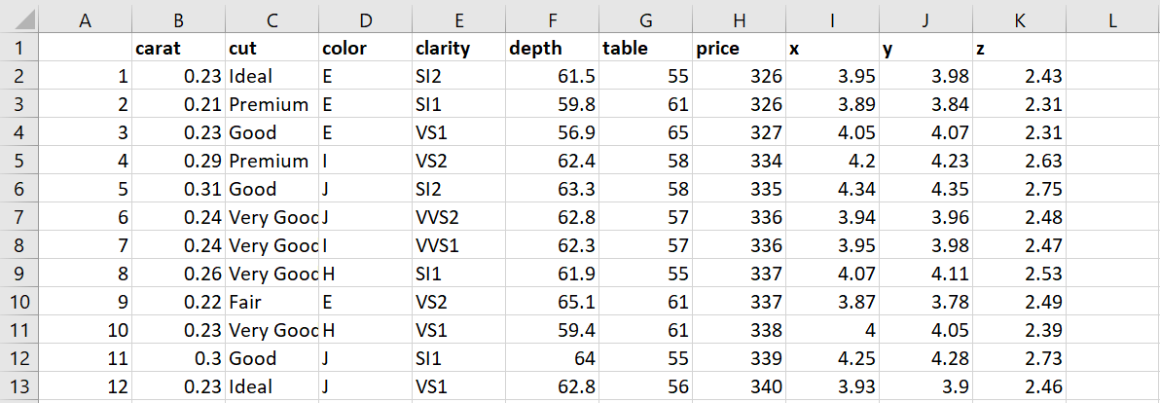
This classic dataset contains the prices and other attributes of almost 54,000 diamonds. It's a great dataset for beginners learning to work with data analysis and visualization.
This classic dataset contains the prices and other attributes of almost 54,000 diamonds. It's a great dataset for beginners learning to work with data analysis and visualization.
Overview
Dataset
Purpose of Analysis
The four Cs

Slide 4
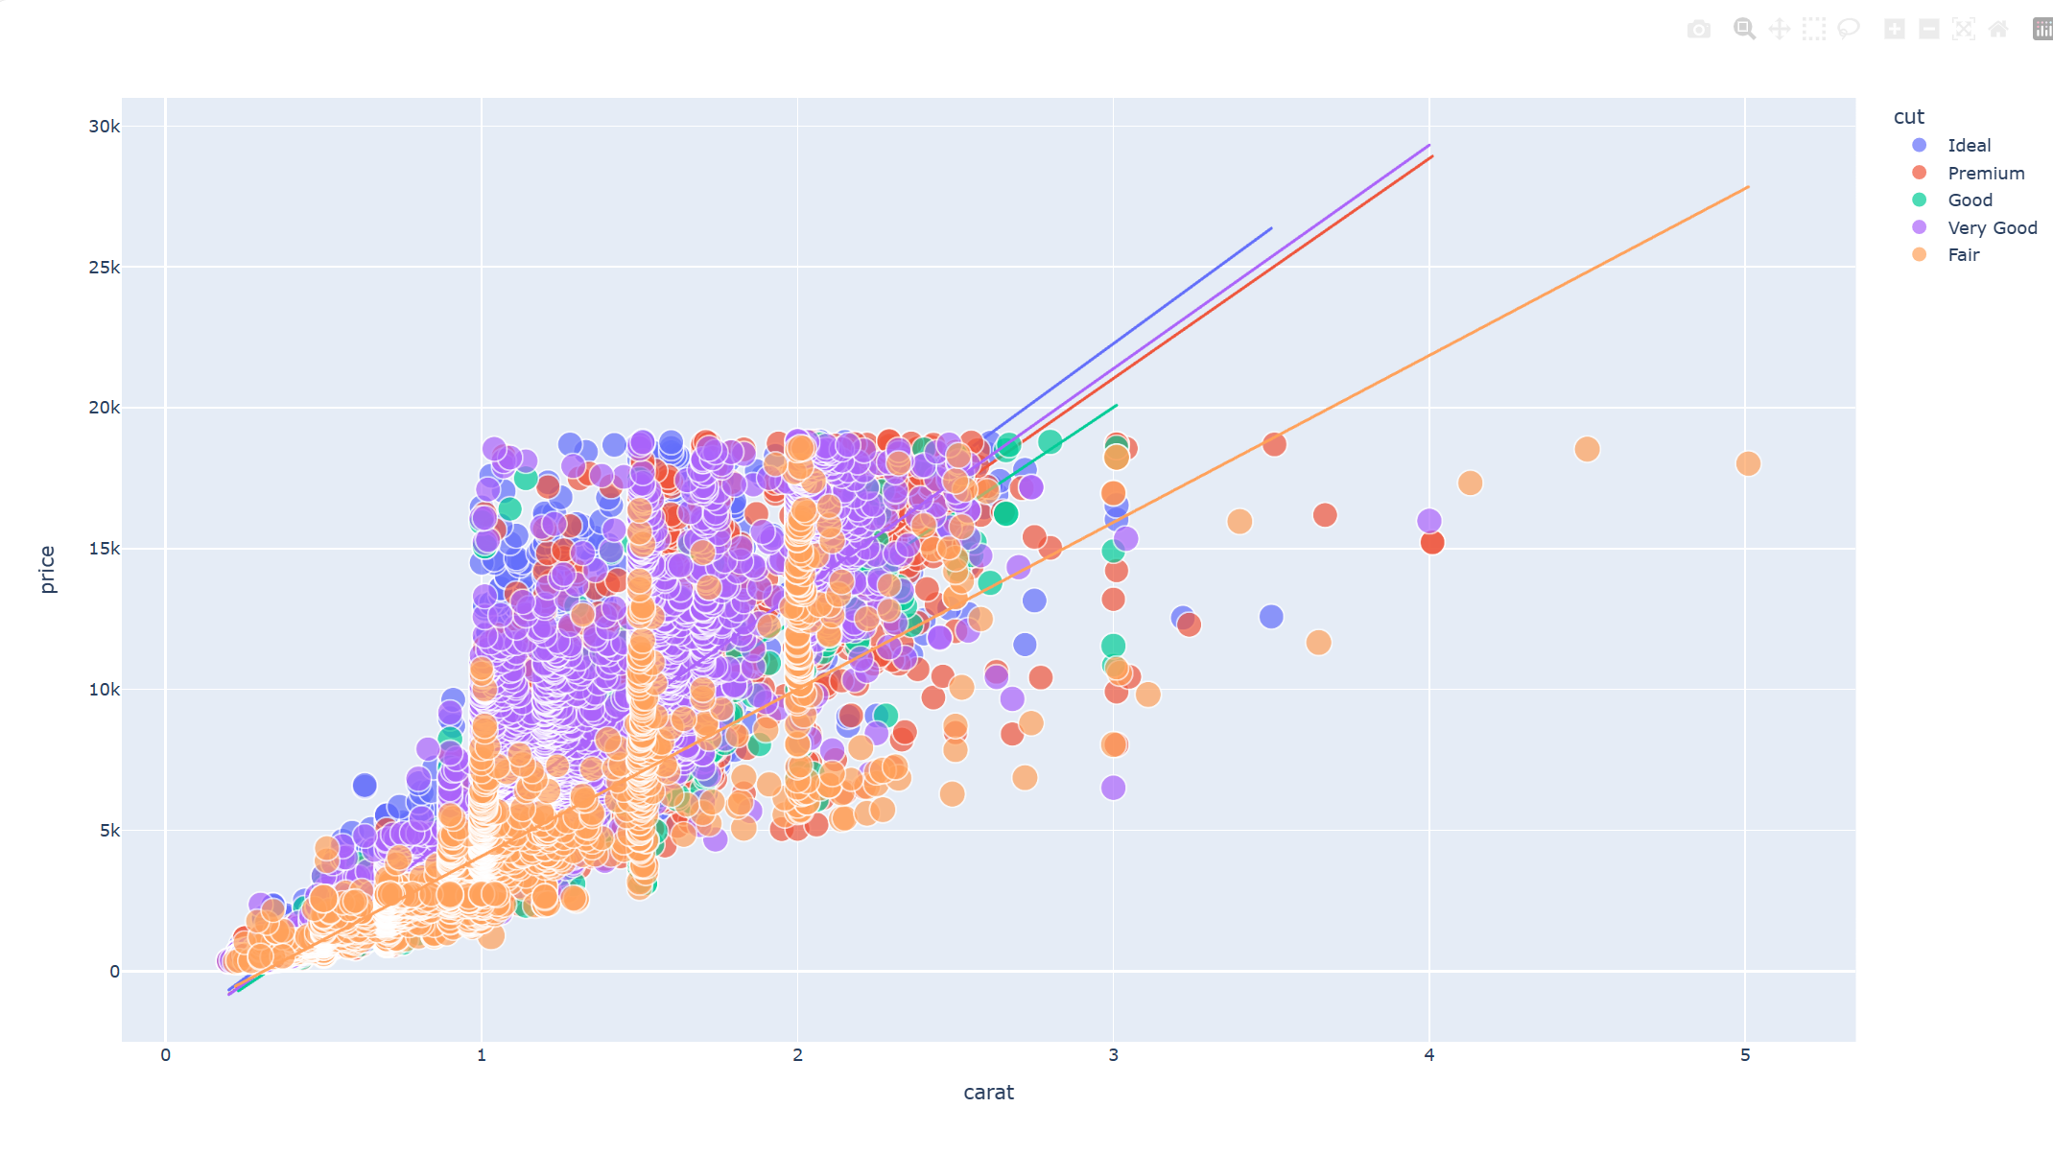
This classic dataset contains the prices and other attributes of almost 54,000 diamonds. It's a great dataset for beginners learning to work with data analysis and visualization.
Analysis helps identify historical and current price trends in the diamond market. Understanding how prices have evolved over time is crucial for market participants.
Purpose of analysis in diamond price analysis is multifaceted and serves various objectives in understanding and interpreting the dynamics of the diamond market.
Overview
Dataset
Purpose of Analysis
The four Cs

Slide 5
This classic dataset contains the prices and other attributes of almost 54,000 diamonds. It's a great dataset for beginners learning to work with data analysis and visualization.
Overview
Dataset
Purpose of Analysis
The four Cs
The 4 Cs of Diamonds: -
Carat (0.2--5.01)
Cut (Fair, Good, Very Good, Premium, Ideal)
Colour. from J (worst) to D (best) diamonds.
Clarity (I1 (worst), SI2, SI1, VS2, VS1, VVS2, VVS1, IF (best))

Slide 6

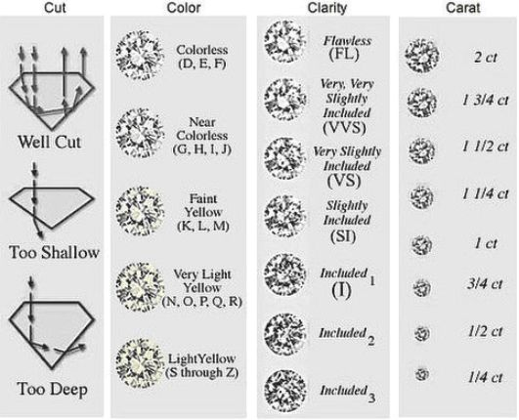
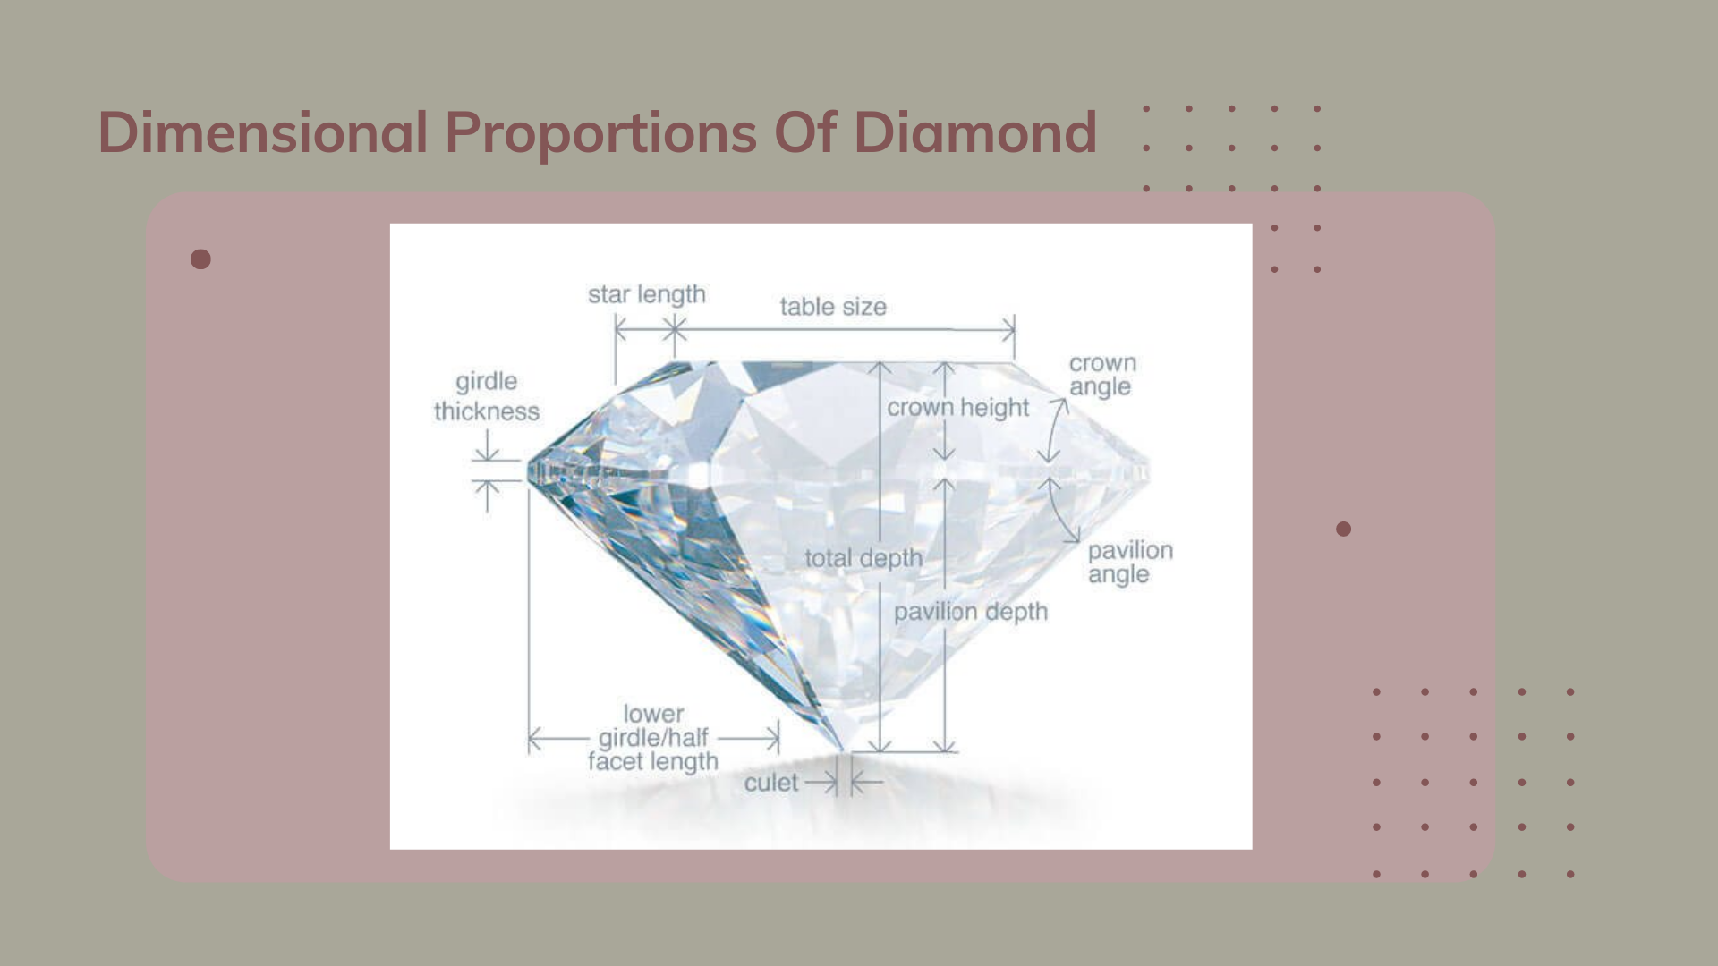
The 4Cs in Diamonds

Slide 7

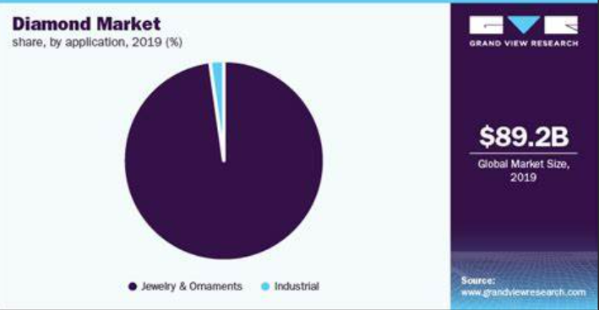
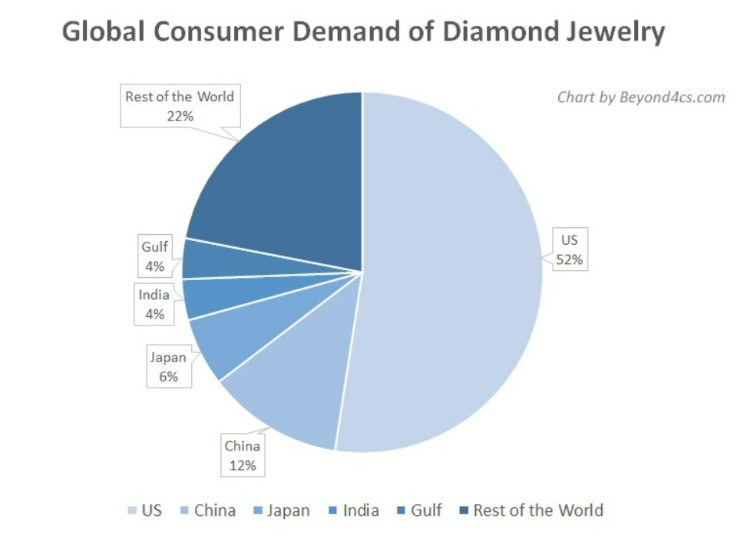
Scope of this Project
Analysing the price of diamonds can be a valuable and relevant project in today's world, considering the dynamic nature of the diamond industry and the factors influencing diamond prices
Study the trends in diamond mining, including new discoveries, mining regulations, and technological advancements. Changes in mining practices can influence the availability and, consequently, the price of diamonds.

Slide 8
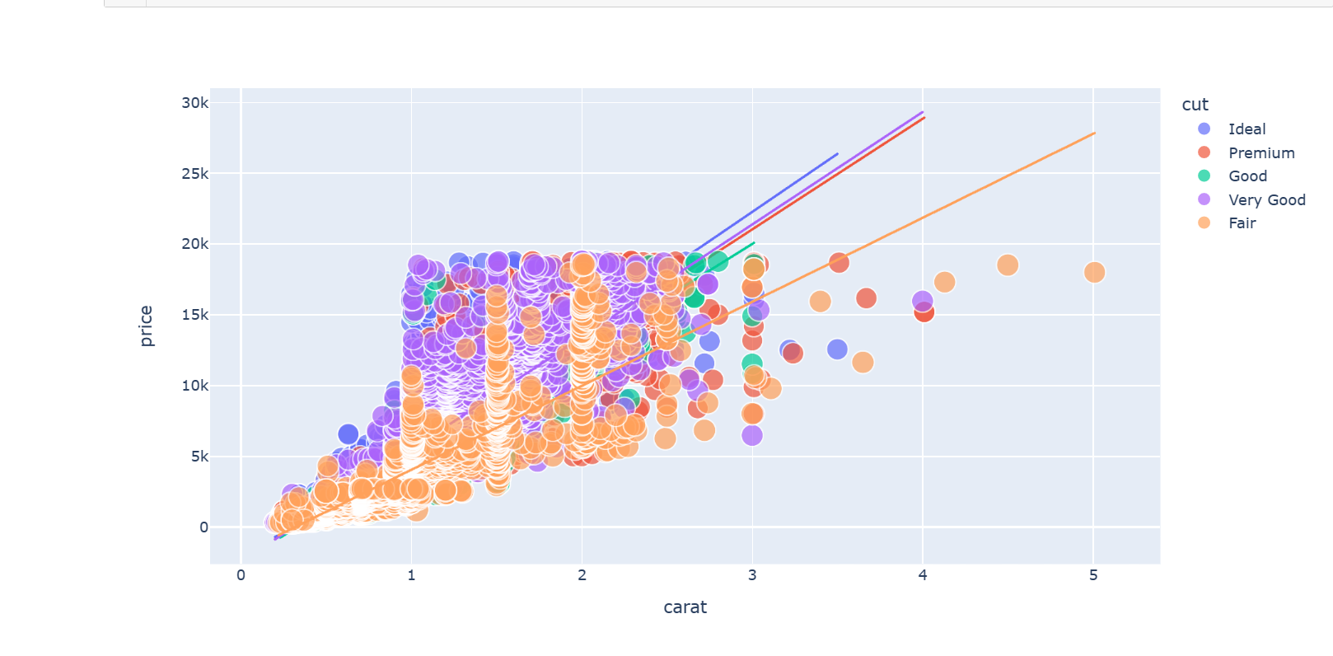
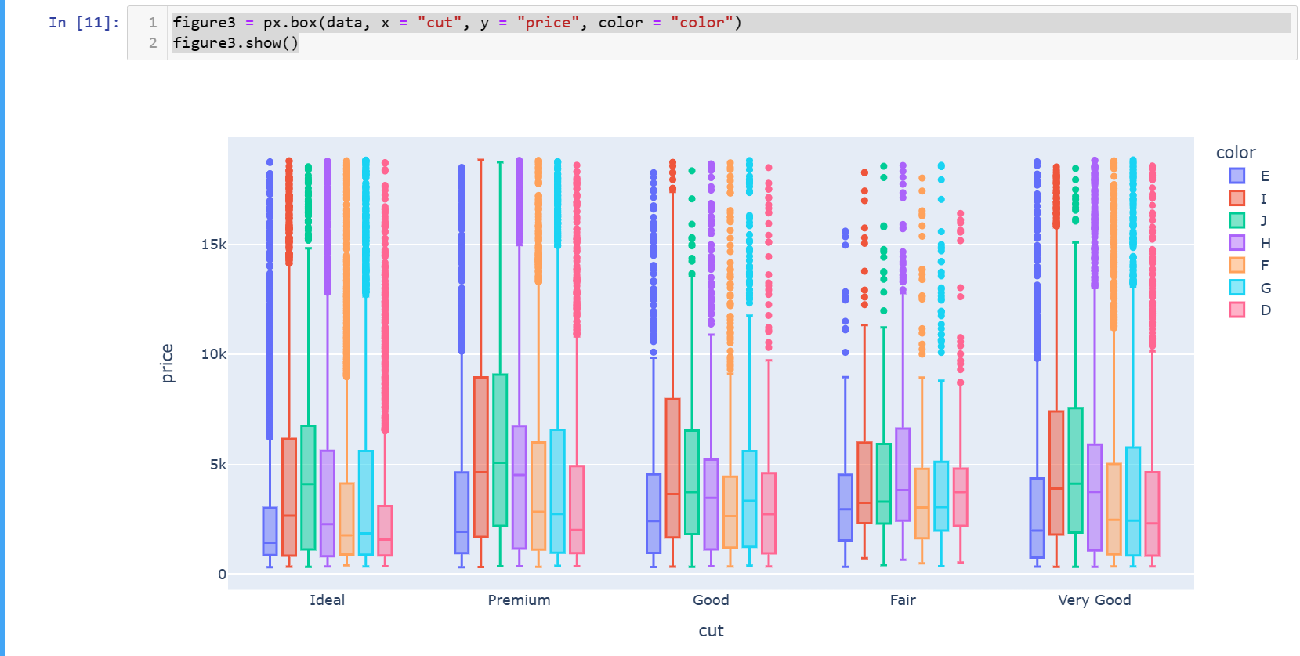
Exploratory Data Analysis
Price v/s Carat Analysis
(Scatter Plot)
Price v/s Cut Analysis
(Box Plot)

Slide 9
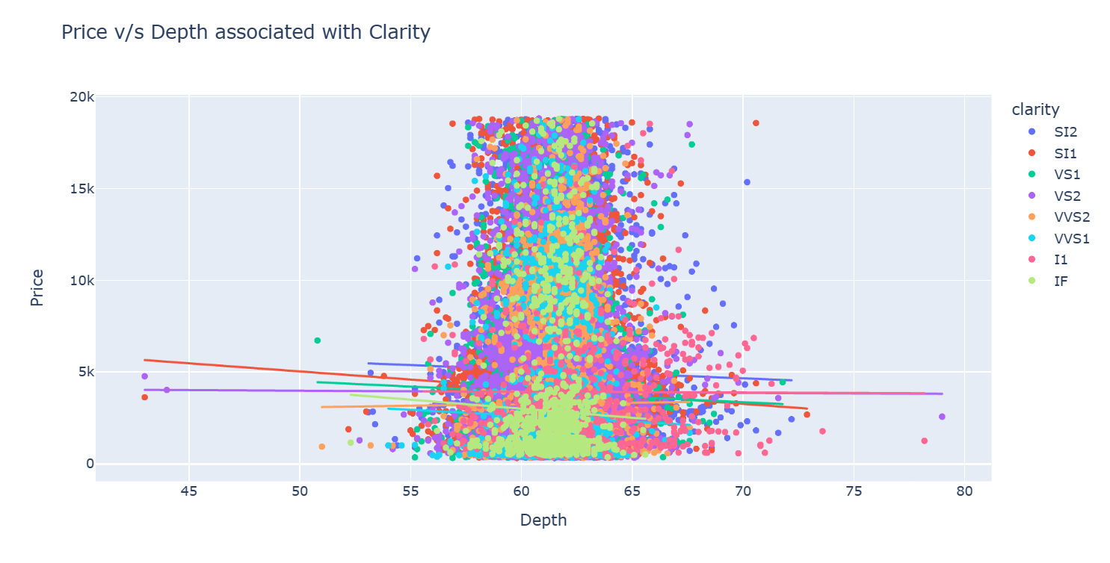
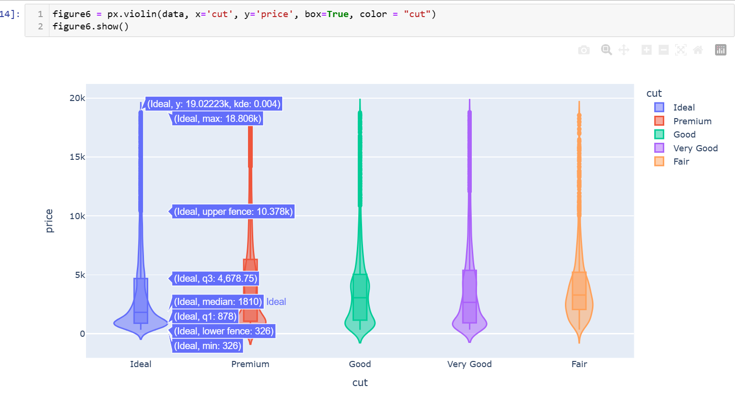
It an analysis approach that identifies general patterns in the data. These patterns include outliers and features of the data that might be unexpected. EDA is an important first step in any data analysis. An initial step in Exploratory Data Analysis (EDA) is to examine how the values of different variables are distributed. Graphical approaches for examining the distribution of the data include histograms, boxplots, cumulative distribution functions, and quantile-quantile (Q- Q) plots.
Price v/s Depth Analysis
(Scatter Plot)
Price v/s Cut Analysis
(Violin Plot)

Slide 10
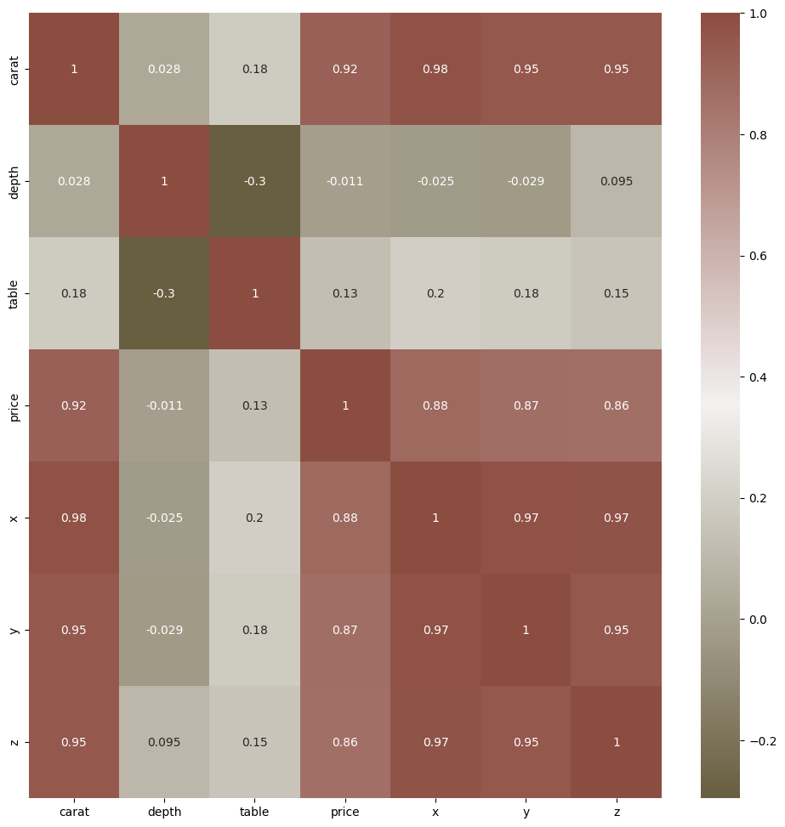
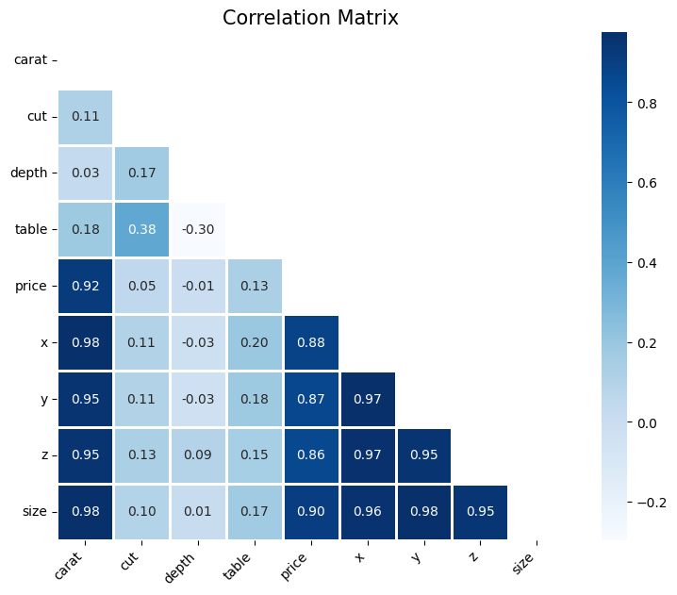
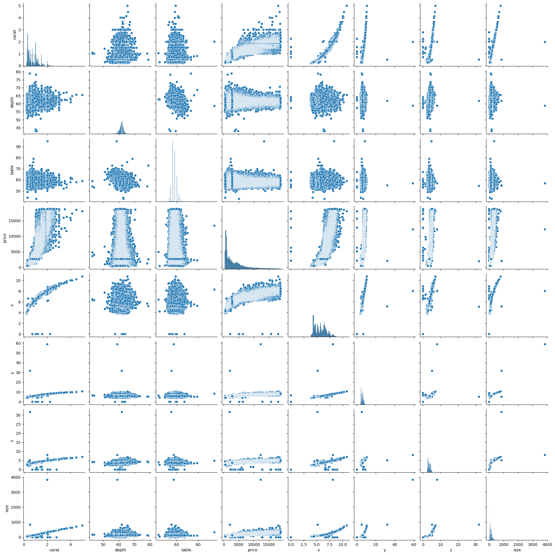
Correlation Matrix

Slide 11

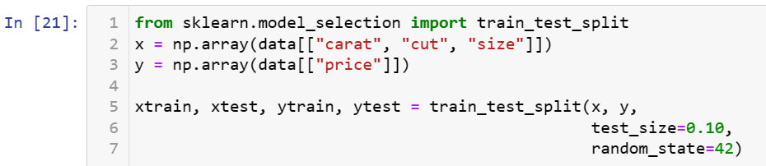
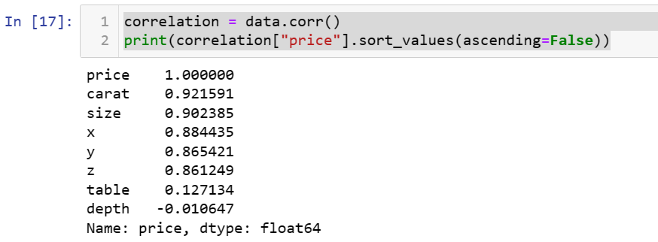
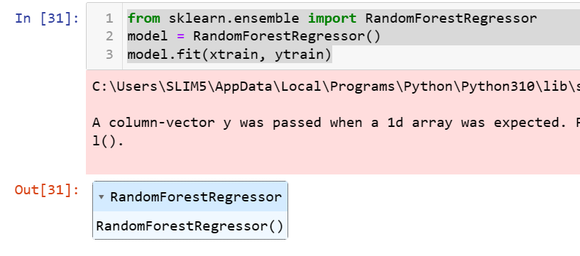
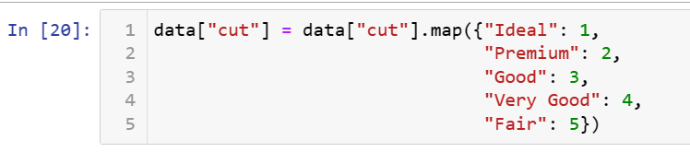
Data Preprocessing
Data preprocessing is a crucial step in diamond price analysis, as it ensures that the data is in a suitable format for analysis and modeling.
Merging and Splitting the Data
Correlation of the columns
Converting the data
Using RandomForestRegressor

Slide 12

Machine Learning Models
Regression analysis is a statistical method that can be incredibly useful in diamond price analysis. It helps to understand the relationship between the dependent variable (in this case, the diamond price) and one or more independent variables (such as carat weight, cut quality, color grade, clarity grade, etc.).
Regression
Creating Pipelines
Mean Absolute Error
Root Mean Squared Error

Slide 13
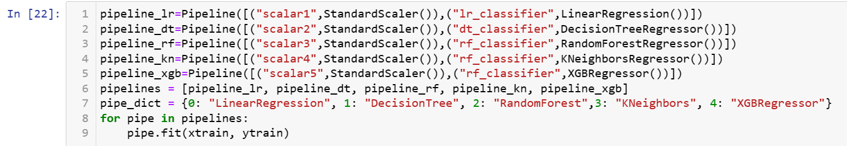
Creating a set of pipelines for different regression models using scikit-learn. The pipelines include a standard scaler for feature scaling and various regression models such as Linear Regression, Decision Tree Regressor, Random Forest Regressor, K-Nearest Neighbors Regressor, and XGBoost Regressor.
Machine Learning Models
Regression
Creating Pipelines
Mean Absolute Error
Root Mean Squared Error

Slide 14
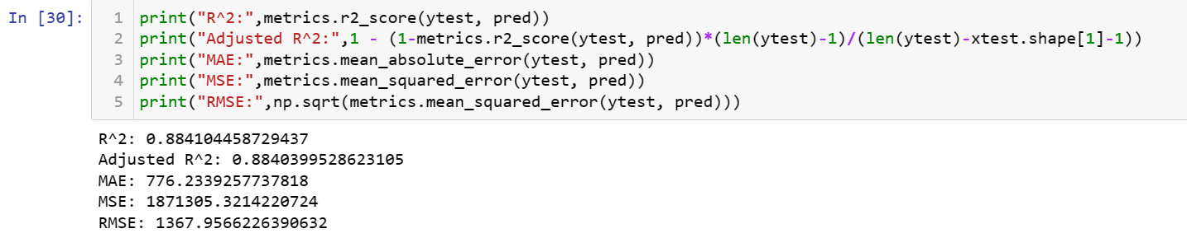
Machine Learning Models
The Mean Absolute Error is a metric that measures the average absolute difference between predicted values and actual values. Mathematically, it is calculated as the average of the absolute differences between the predicted and actual values for each observation.
Regression
Creating Pipelines
Mean Absolute Error
Root Mean Squared Error

Slide 15
Machine Learning Models
RMSE provides a measure of the average magnitude of errors between predicted and actual diamond prices. A lower RMSE indicates better model performance. In diamond price analysis, where the goal is to predict a continuous variable (price), RMSE helps assess the overall accuracy of regression models.
Regression
Creating Pipelines
Mean Absolute Error
Root Mean Squared Error

Slide 16
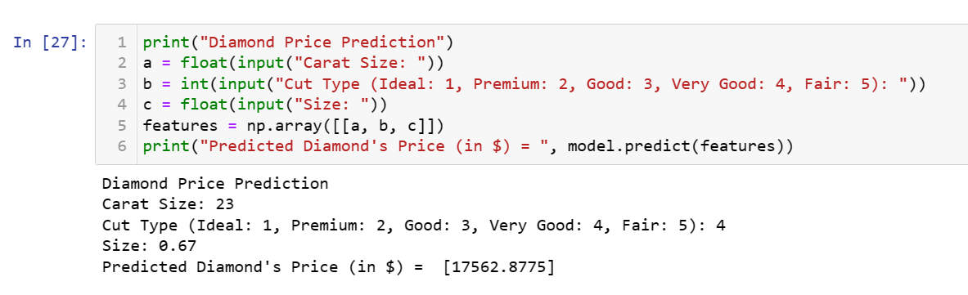
Final Output
This code prompts the user to input values for carat size, cut type, and size. It then creates a feature array based on the user input and uses the trained Random Forest Regressor (model) to predict the diamond's price. imports the RandomForestRegressor class from scikit-learn, creates an instance of the model, and then trains it on the training data (xtrain and ytrain).
After running this code, the model variable now contains a trained Random Forest Regressor, and you can use it to make predictions on new data or evaluate its performance.

Slide 17
Final Output
Inserting the carat size
Inserting the Cut Type
Entering the size (h*w*d)
Final Output (in $)

Slide 18
Future Enhancement
The working of the diamond price prediction project and improve its capabilities, but there might be future enhancement as well. That might give you accurate price as well as knowledge about future technology
Improve the user interface for input collection, providing users with clear instructions and feedback. Consider incorporating user feedback mechanisms to continually refine
Consider exploring more advanced regression models or neural network architectures to capture complex relationships in the data.
might derive new features from existing ones or incorporate external data sources. Investigate Interactions between features and assess their impact on the model's performance.

Slide 19
Conclusion
So far, we conclude our project by creating a user-friendly interface. I have not only created an interface but also studied about Regressions and EDA
The project allows users to input information about a diamond (carat size, cut type, and size) and receive a predicted price based on the trained regression model.
Evaluated the model's performance on the testing set using appropriate metrics such as R-squared, Mean Absolute Error (MAE), Mean Squared Error (MSE), or Root Mean Squared Error (RMSE).
Provided a user interface for diamond price prediction, allowing users to input diamond features and receive predicted prices. The success of your diamond price prediction project depends on the accuracy of your models and their ability to generalize well to new, unseen data.

Slide 20

Thank You

